Slide 1
Whose Test Is It Anyway?
Maaret Pyhäjärvi

Slide 2
Core message
Developers can test.
Testers need to test better than we do at large today.

Slide 3
Social
Software
Testing
Approaches
Exploratory Testing
Programmatic Tests
Notes:
… a particularly confusing
intersection

Slide 4
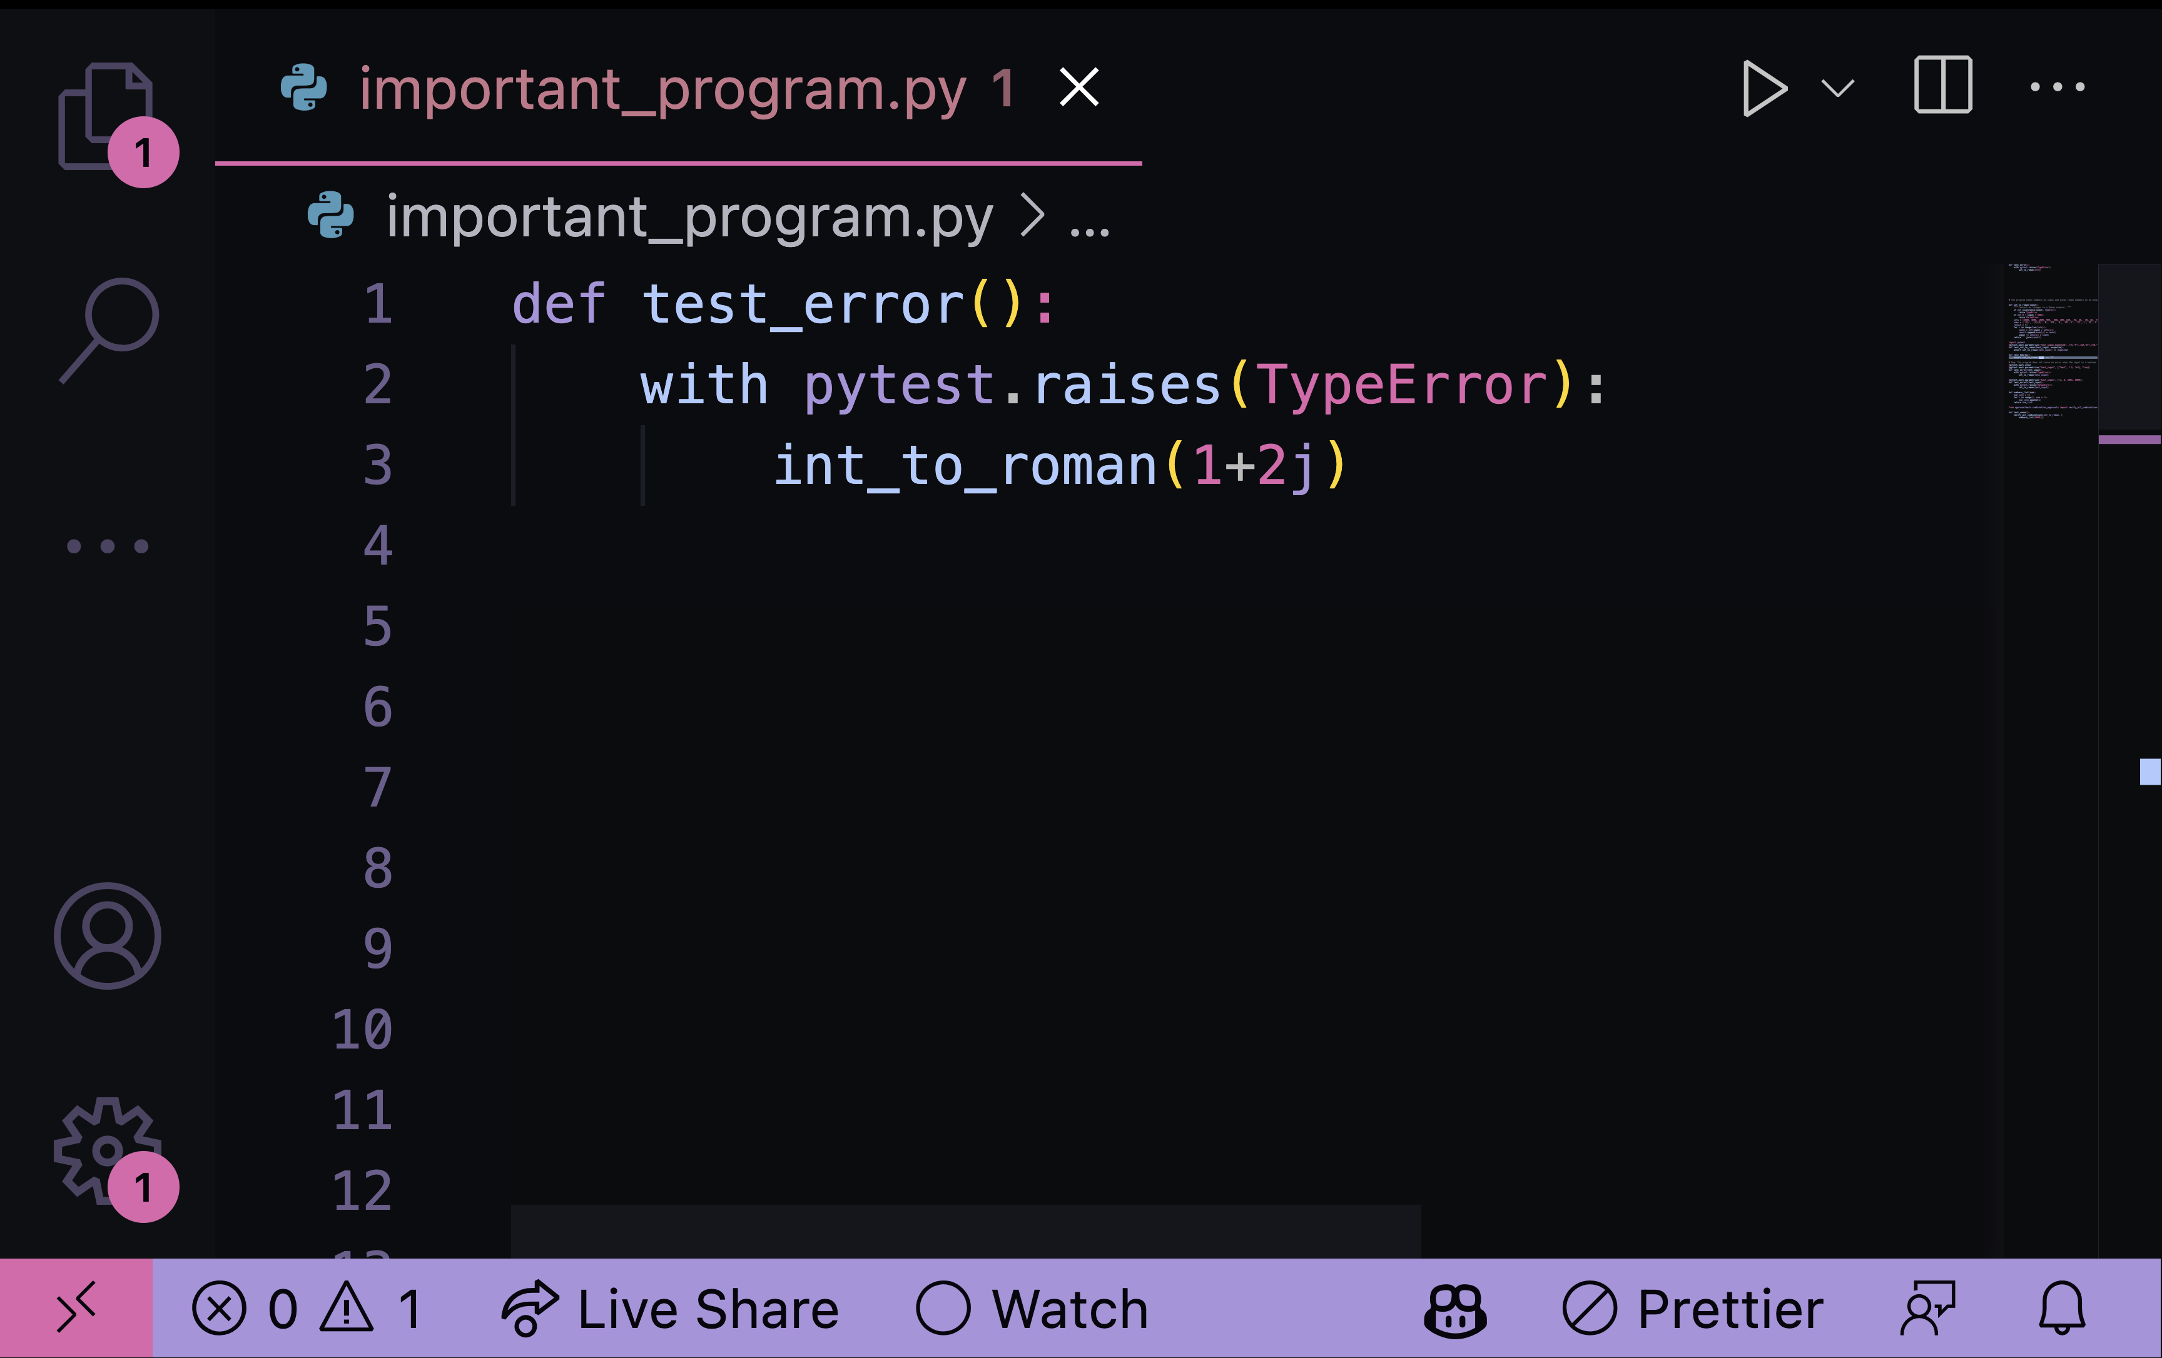
This is a test.
Whose test is it?

Slide 5

Improv
performance
Notes:
Audience suggestions
Predetermined prompts
Software as external imagination!!!

Slide 6
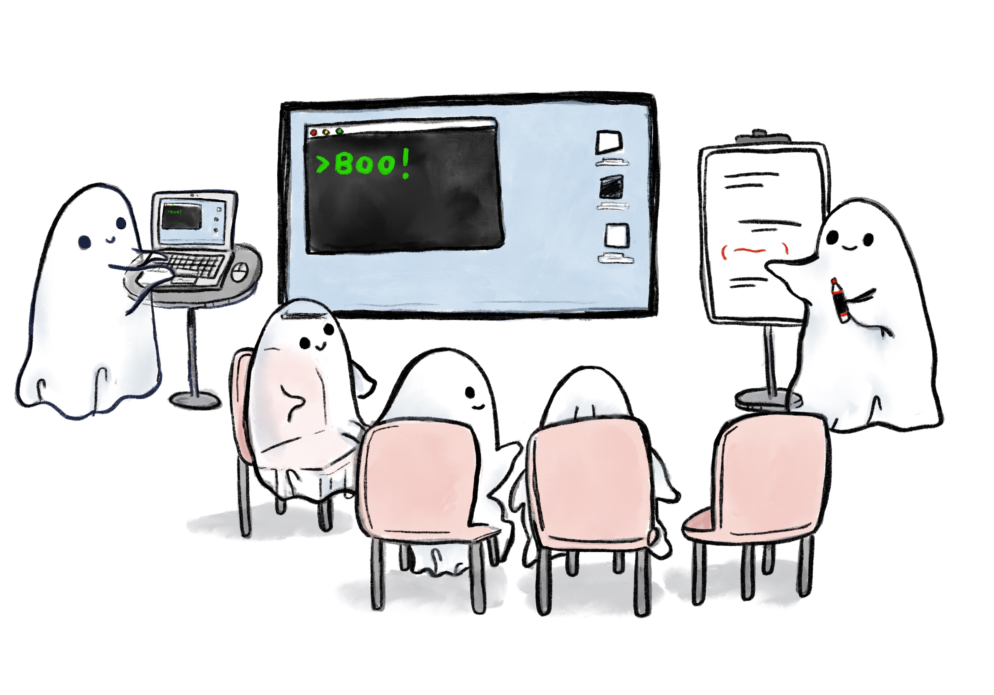
Designated Navigator (Voice)
Driver (Hands)
Navigators (Brains)

Slide 7
Developers.
Developers Team members with emphasis on programming.
Testers.
Testers Team members with emphasis on testing (and programming on testing problems).

Slide 8
”Find (some of) What Others May Have Missed”
Stakeholders happy, even delighted
–Quality Information
Surprise!
Results Gap
Good Team’s Output
–Quality Information
Results Gap on a Team that thinks
Testers == Testing
Pick up the pizza boxes…
Less than Good Team’s Output
–Quality Information

Slide 9
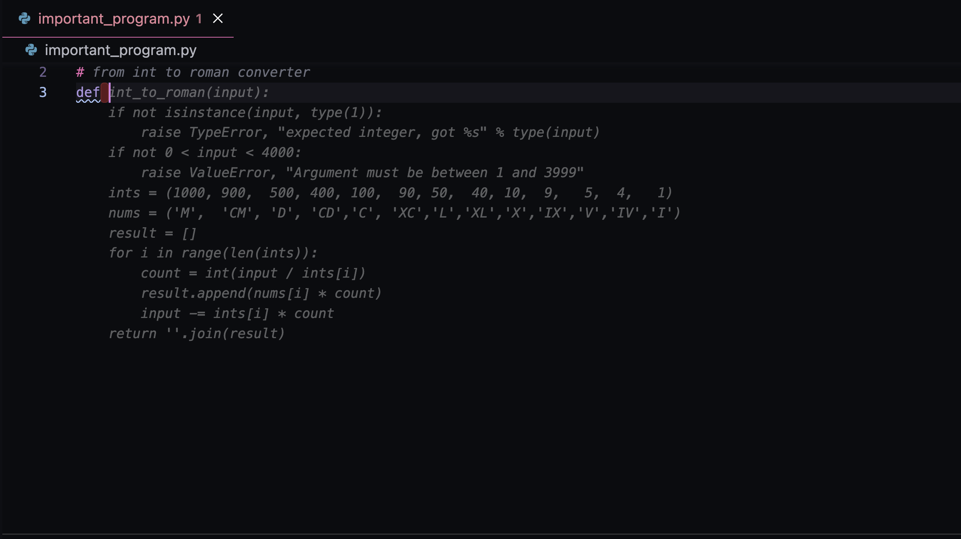

Computer Assisted Software Authorship
https://github.com/features/copilot/

Slide 10
1. Legal / Ethical
2. Intent / Implementation
3. Domain for the Layman
4. Domain for the Expert
5. Reference Implementation
6. People Filtering 7. Interesting side effects
WE are
accountable

Slide 11
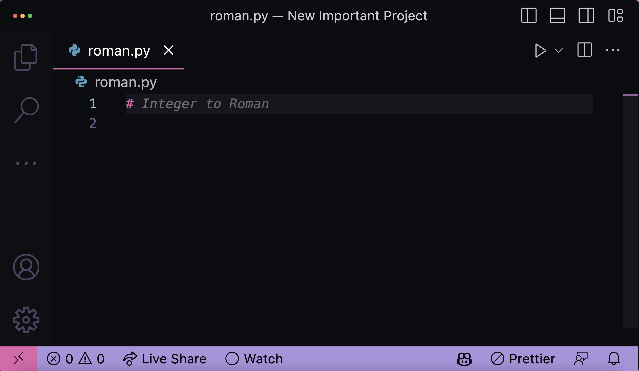
Guessing with power to accept
For Mood: https://aboutmonica.com/blog/how-to-make-your-vs-code-sparkle/

Slide 12
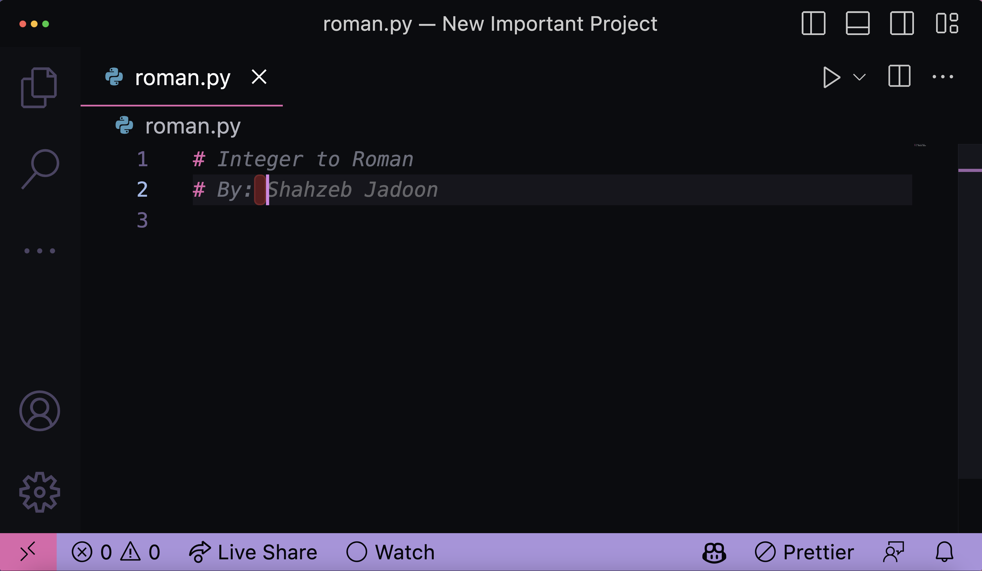
Guessing with power to accept
Who Am I?
What am I testing again? My program or the tool?

Slide 13
Note:
…pillaging digital content without consent, compensation and attribution
Even if legal not ethical.

Slide 14
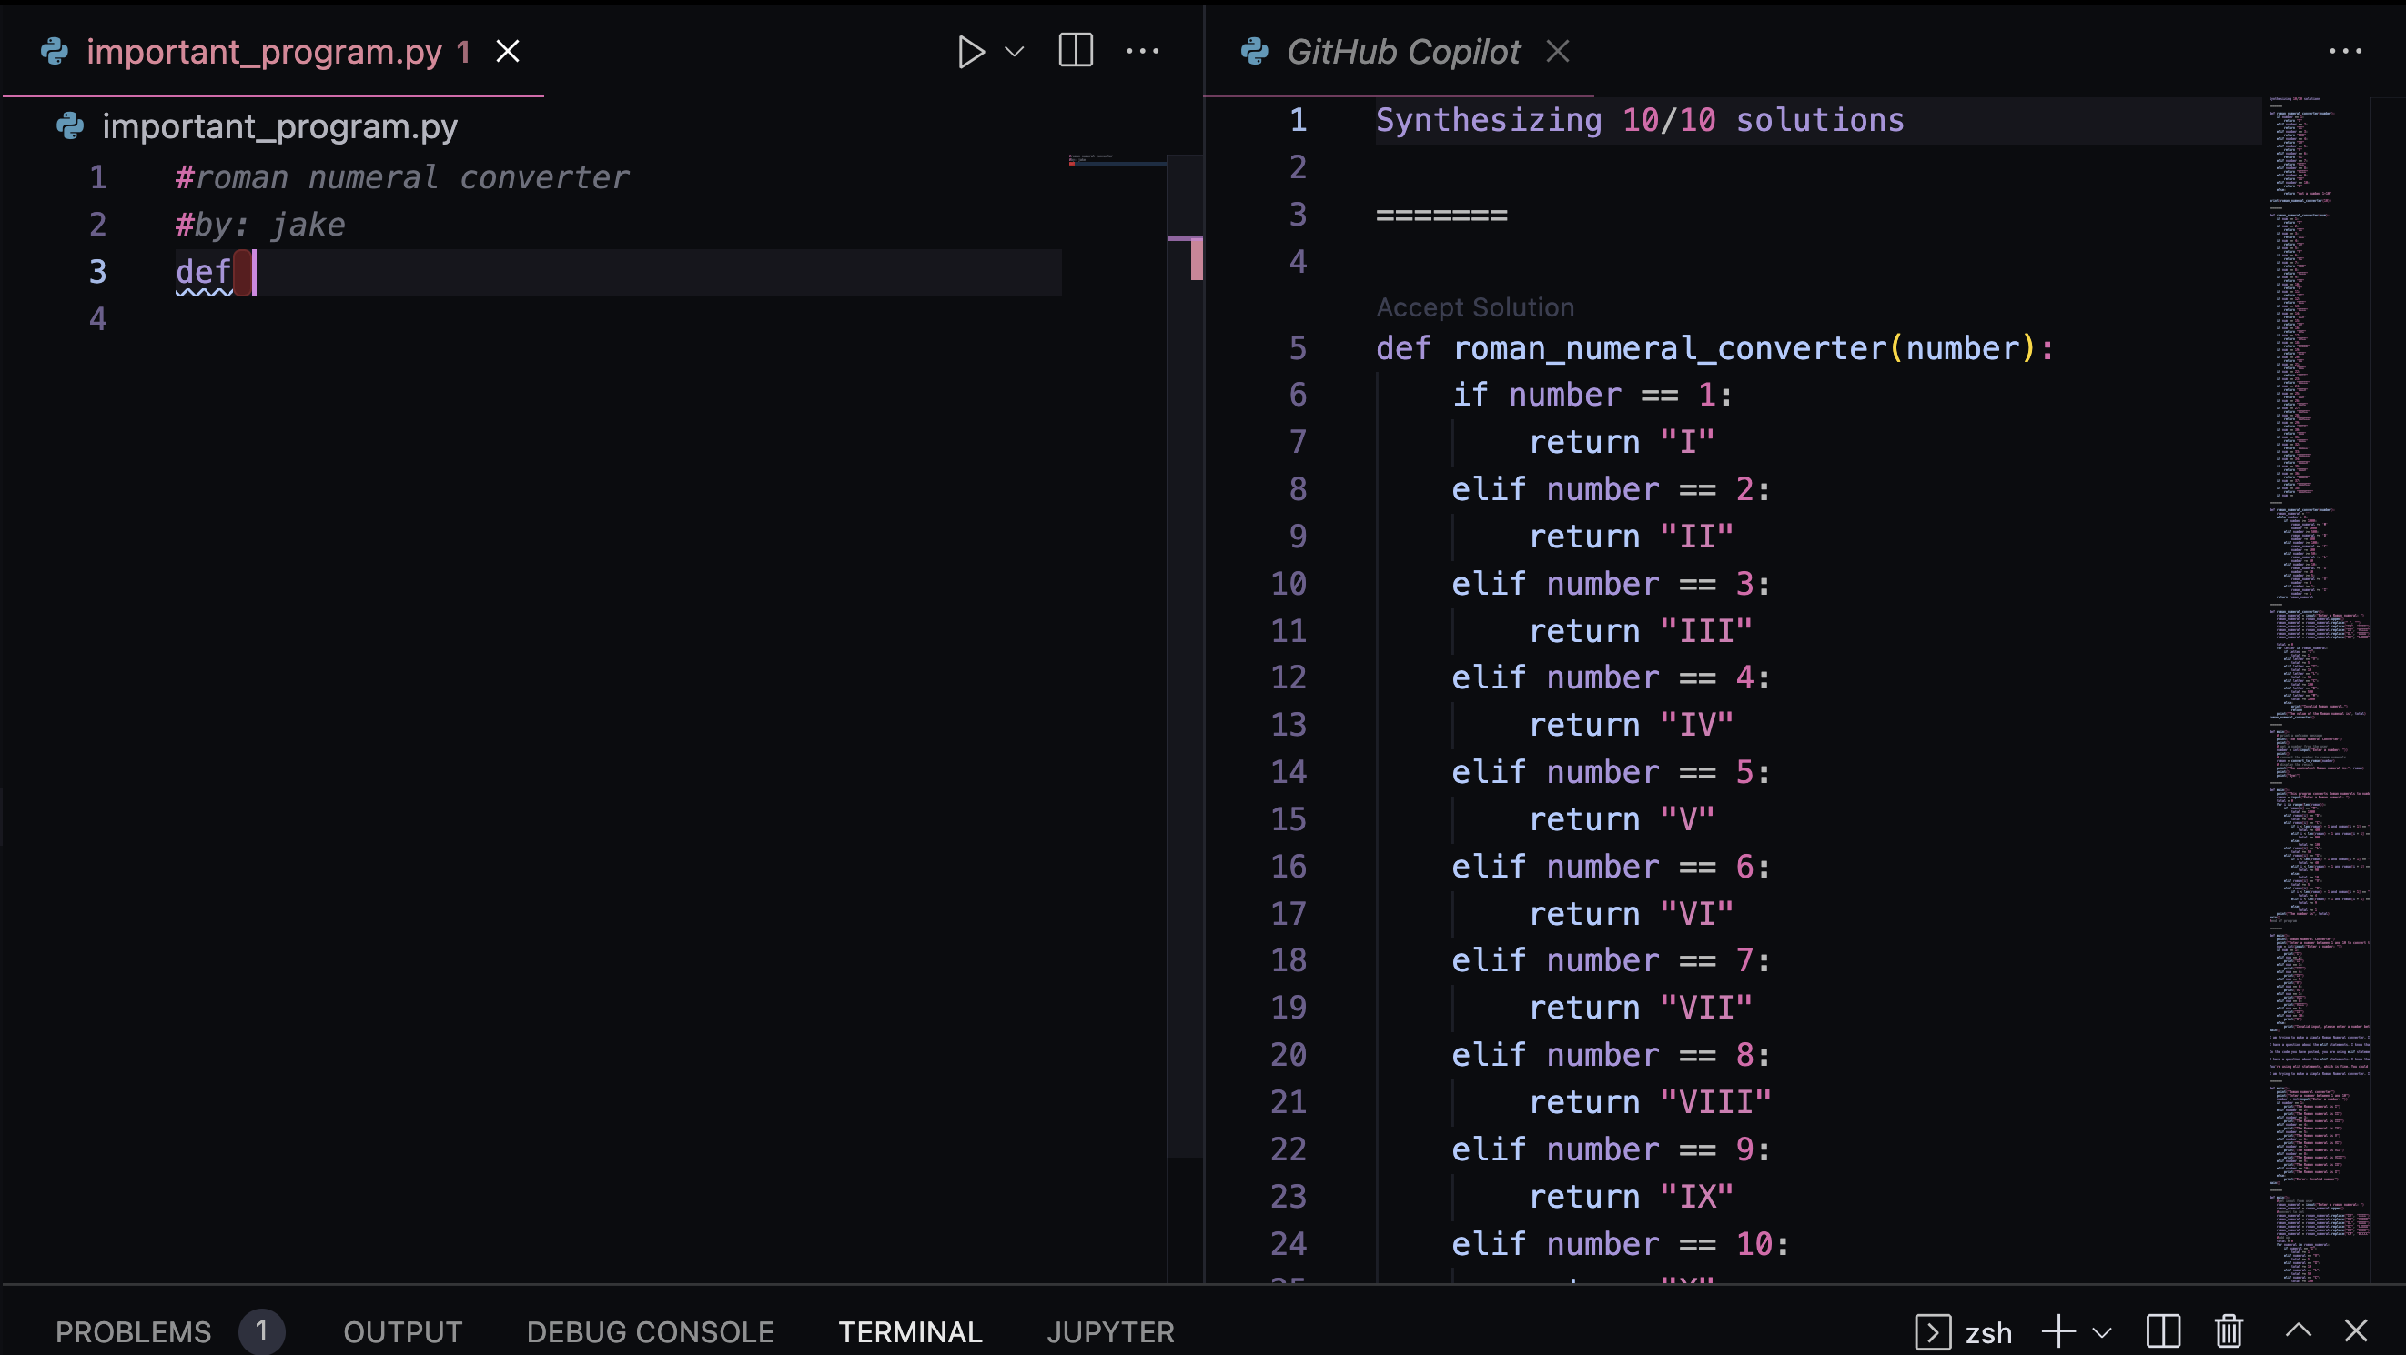
Code Review
CTRL+enter for alternatives

Slide 15
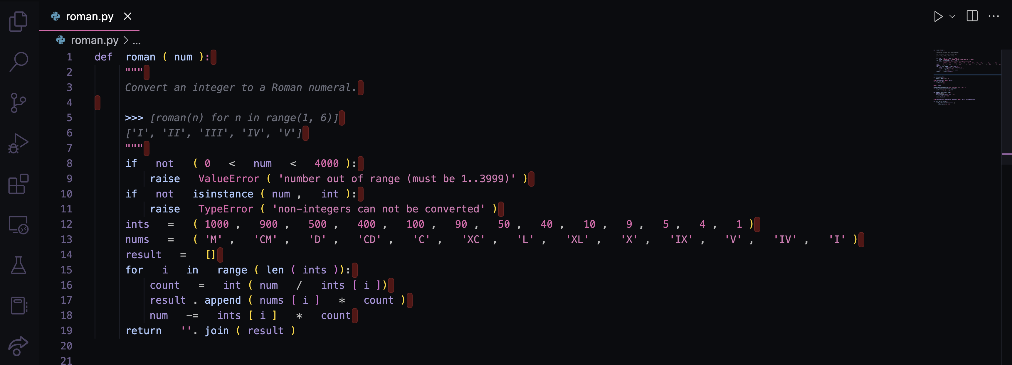
Say We Have This…
Done?

Slide 16
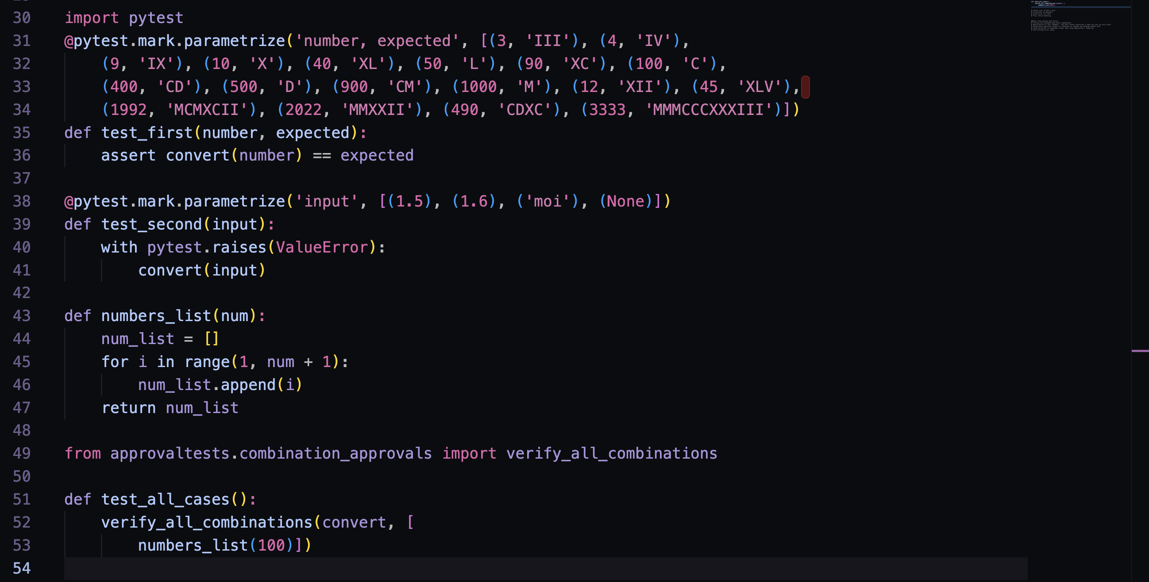
Some Tests
Done?

Slide 17
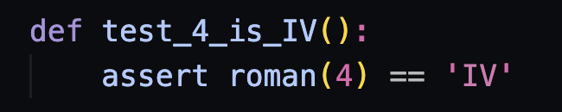
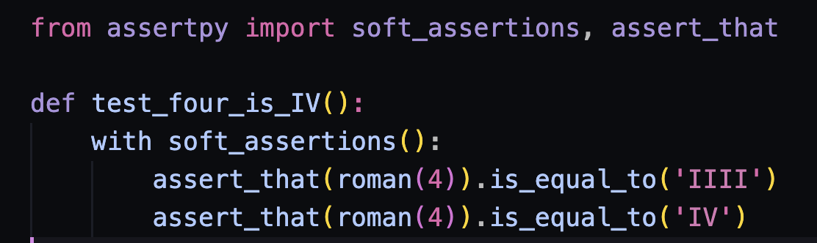
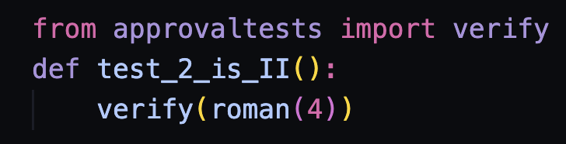
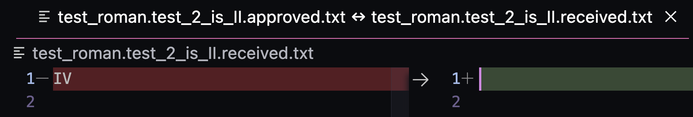
Shapes of Approaches
Asserts
Approvals

Slide 18
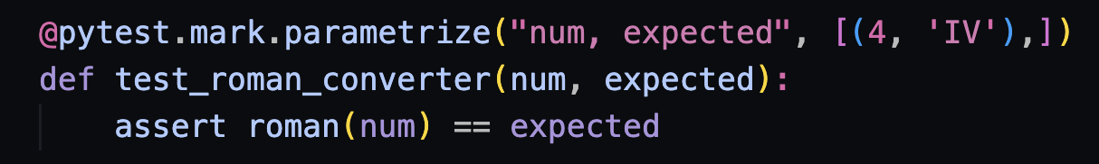
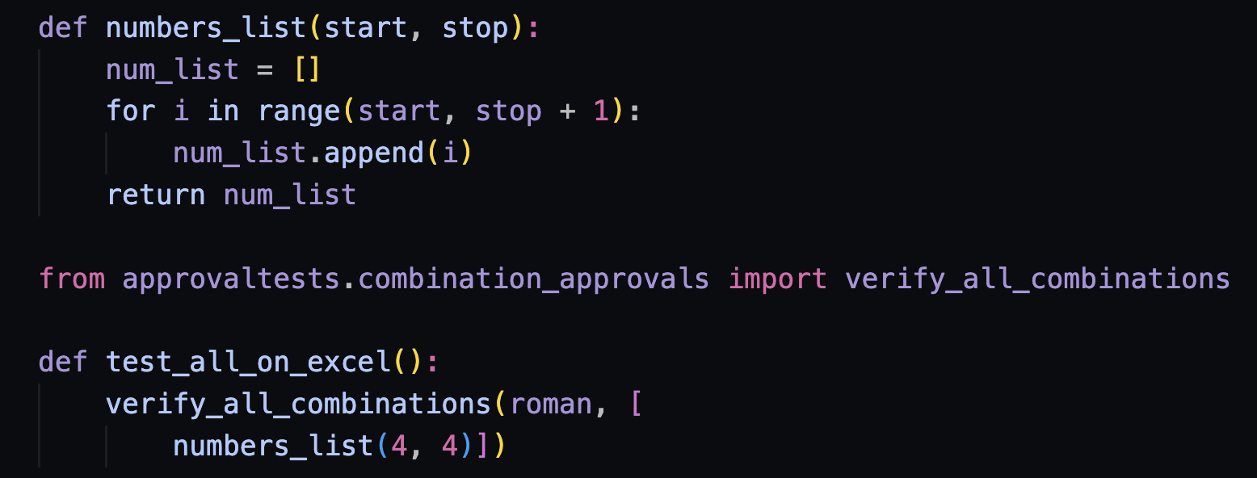
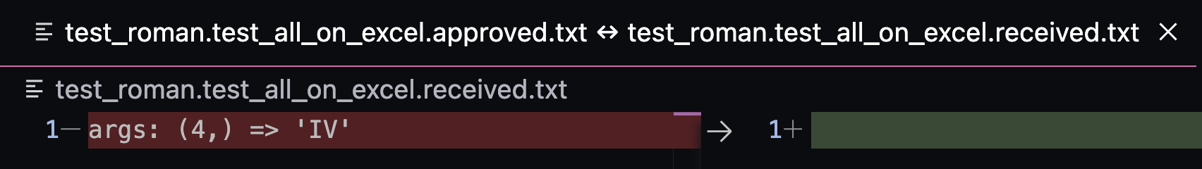
From One to Many
Asserts
Approvals

Slide 19
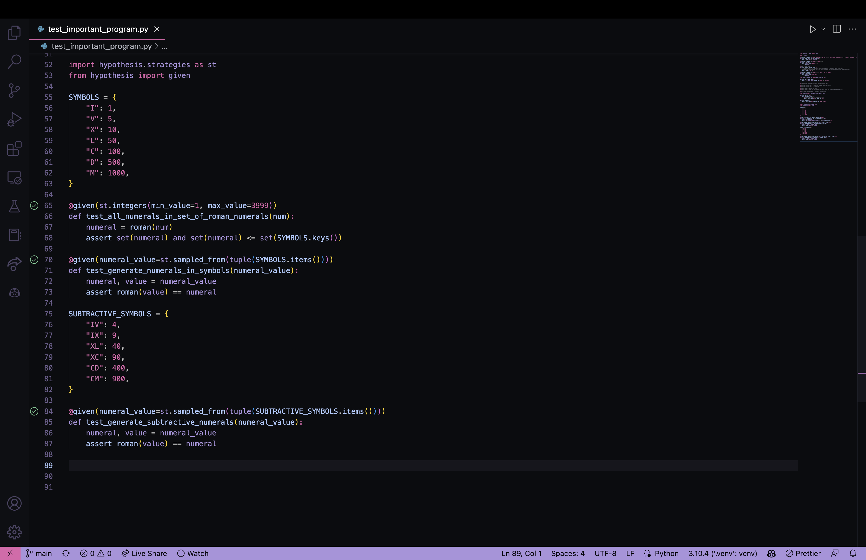
Hypothesis

Slide 20
Note:
…developer intent. It might not do what you wanted it to do.

Slide 21
Developer intent
Part I. Review for correctness and conciseness
Part II. Input → Output
Part III. Rules of behavior boundaries
Part IIII. Coverage
Part IIIII. Sampling vs wide nets (approvals)
Part VI. Properties

Slide 22
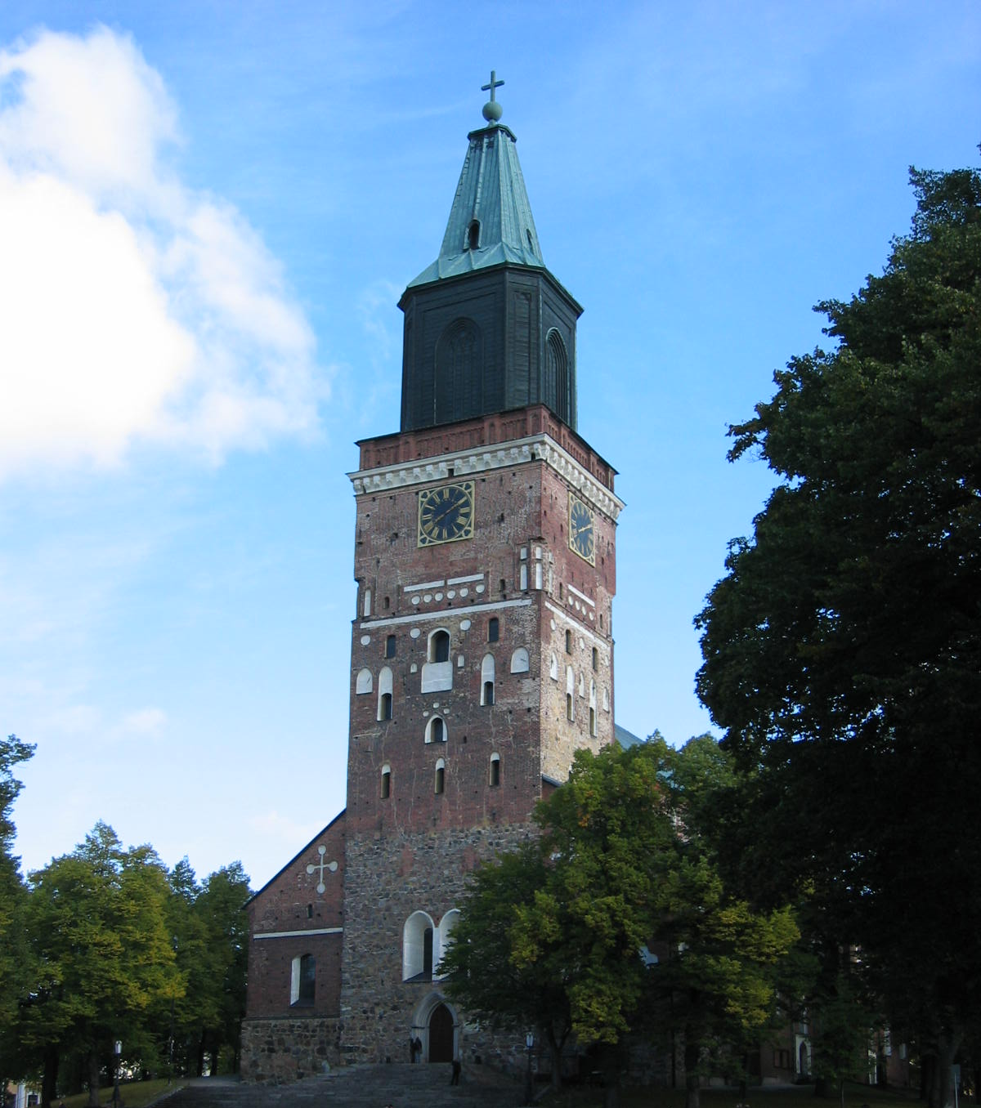
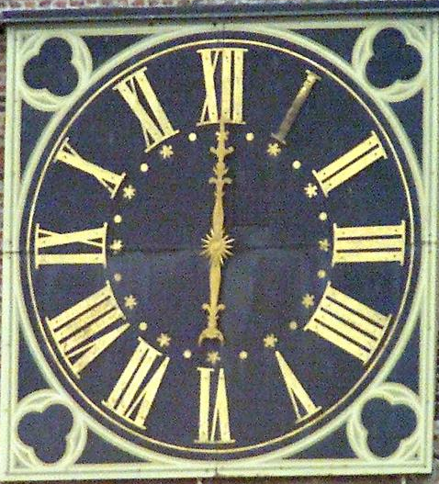
Domain rules: 1V → IIII in clock design as per orders of King Louis XIV of France
https://www.amalgamsab.com/iiii-or-is-it-iv.html
Notes:
Tombstones: 5→ IIIII and 50 -> XXXXX

Slide 23
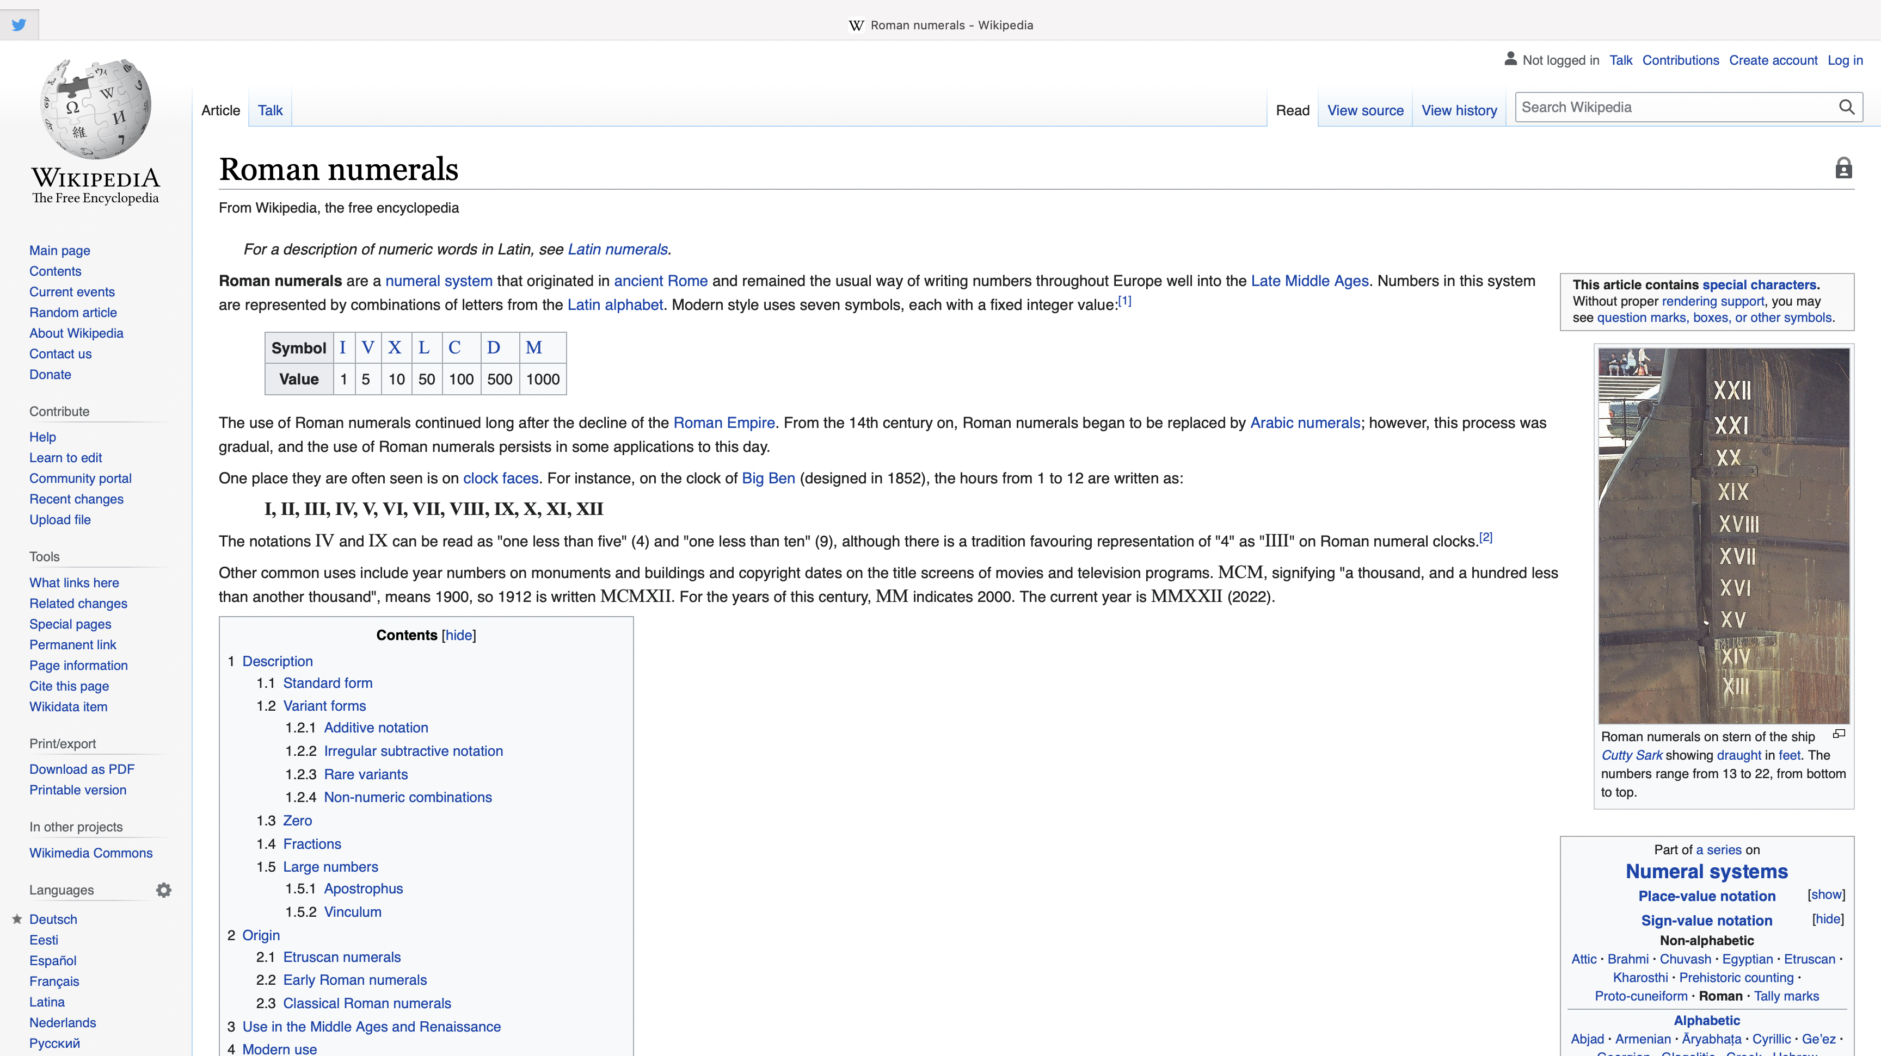
https://en.wikipedia.org/wiki/Roman_numerals

Slide 24
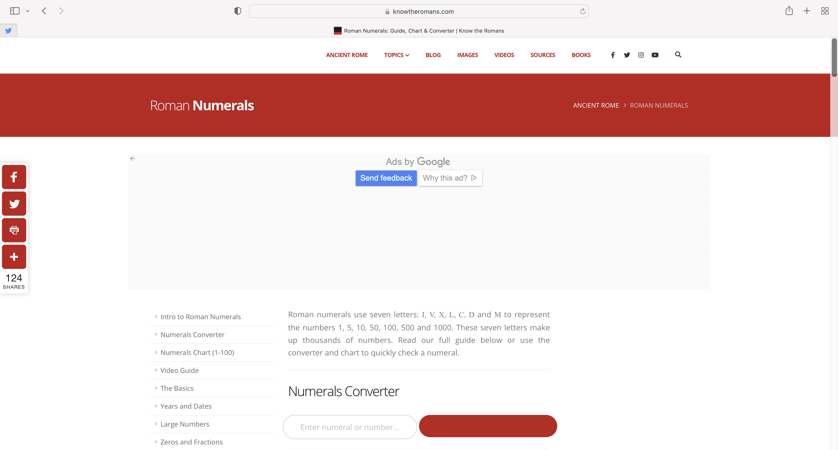

Slide 25

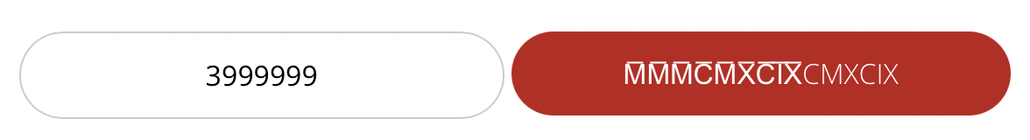
Upper Boundary?

Slide 26
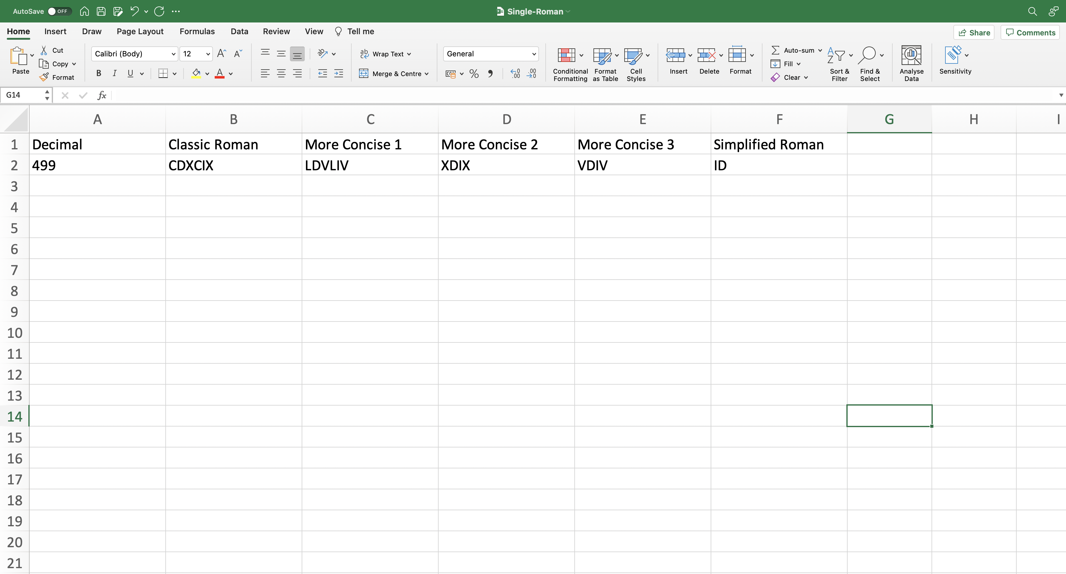

Slide 27
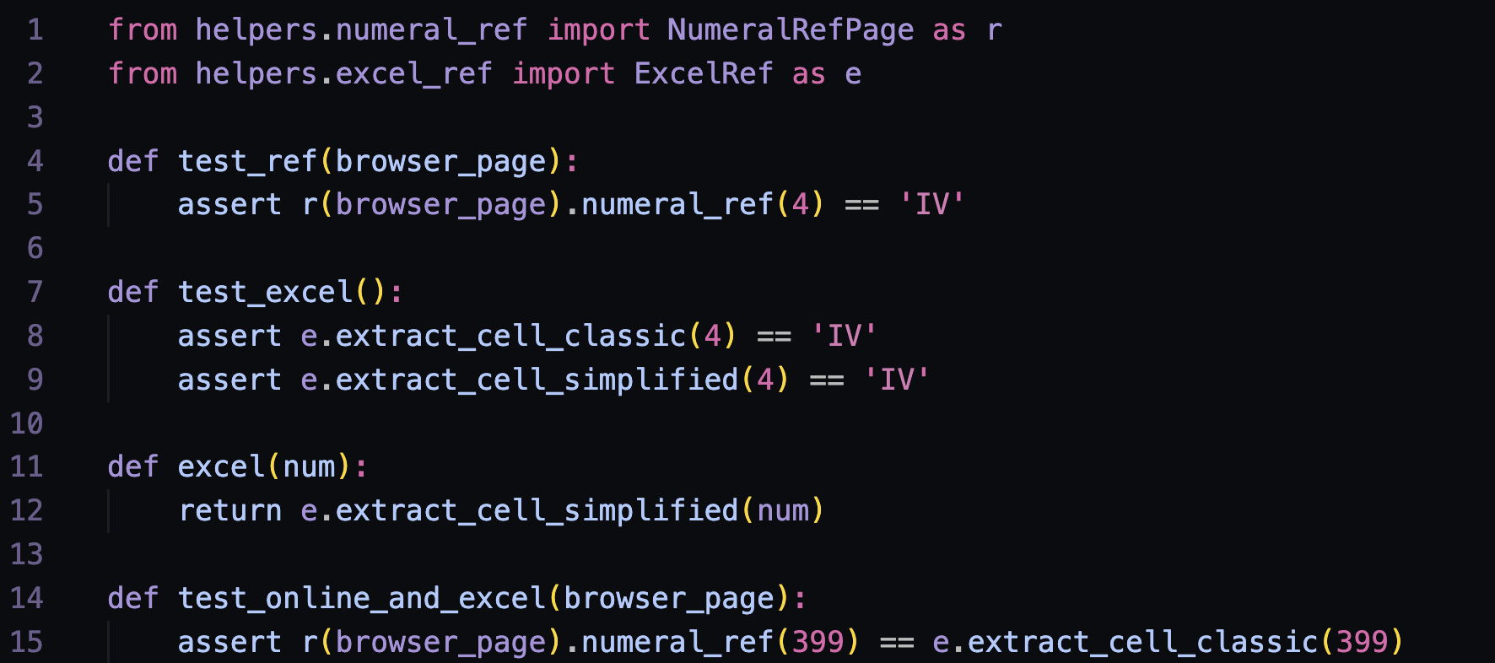
References…
References…

Slide 28
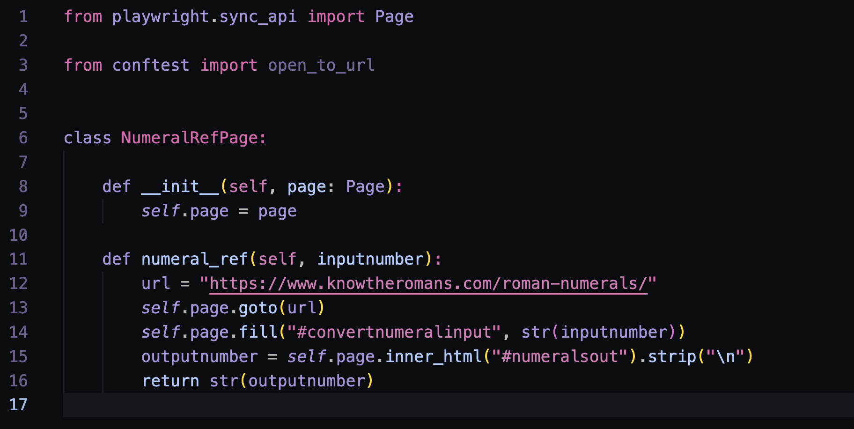
References…

Slide 29
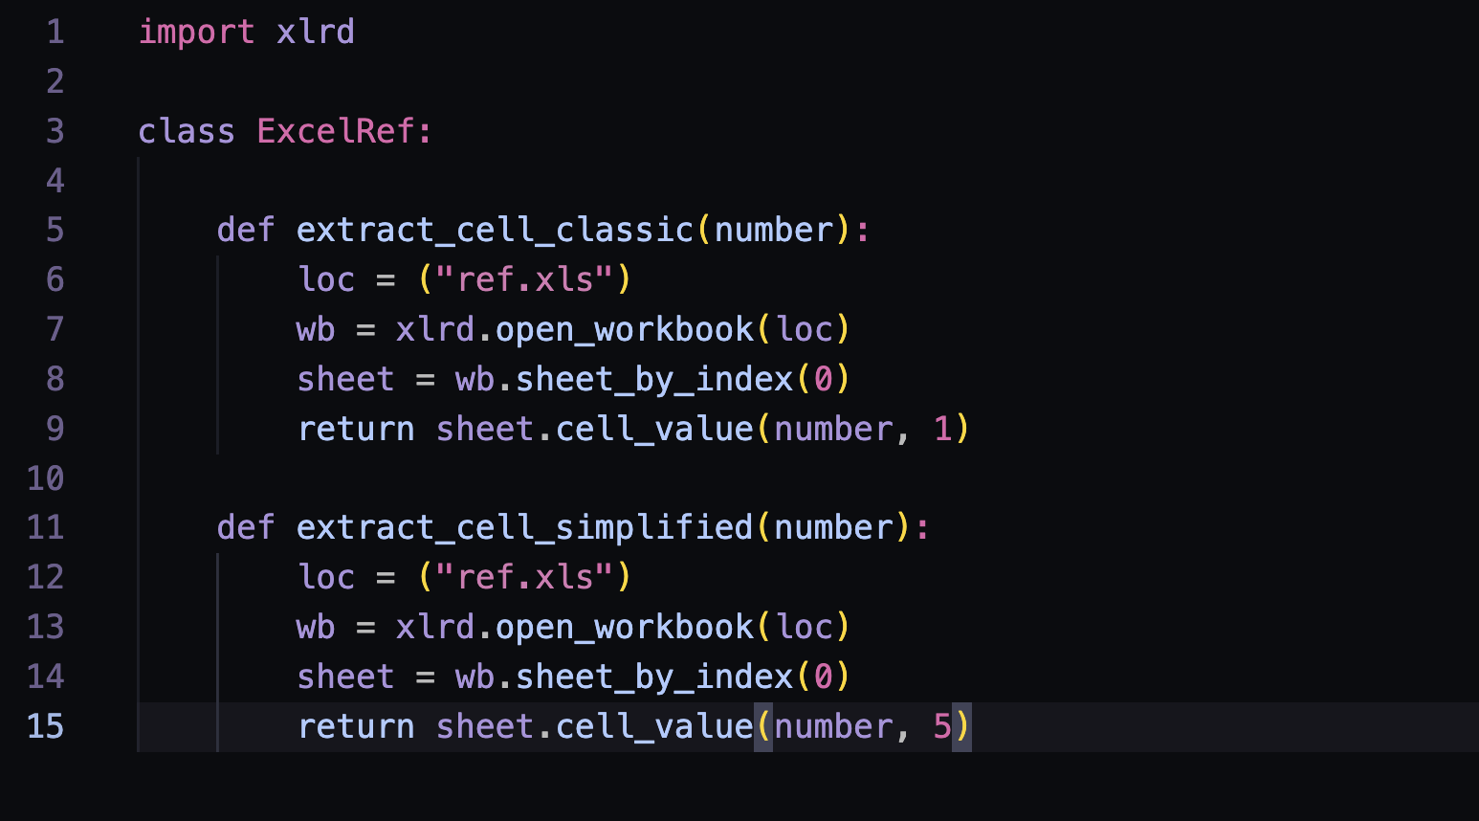
References…

Slide 30
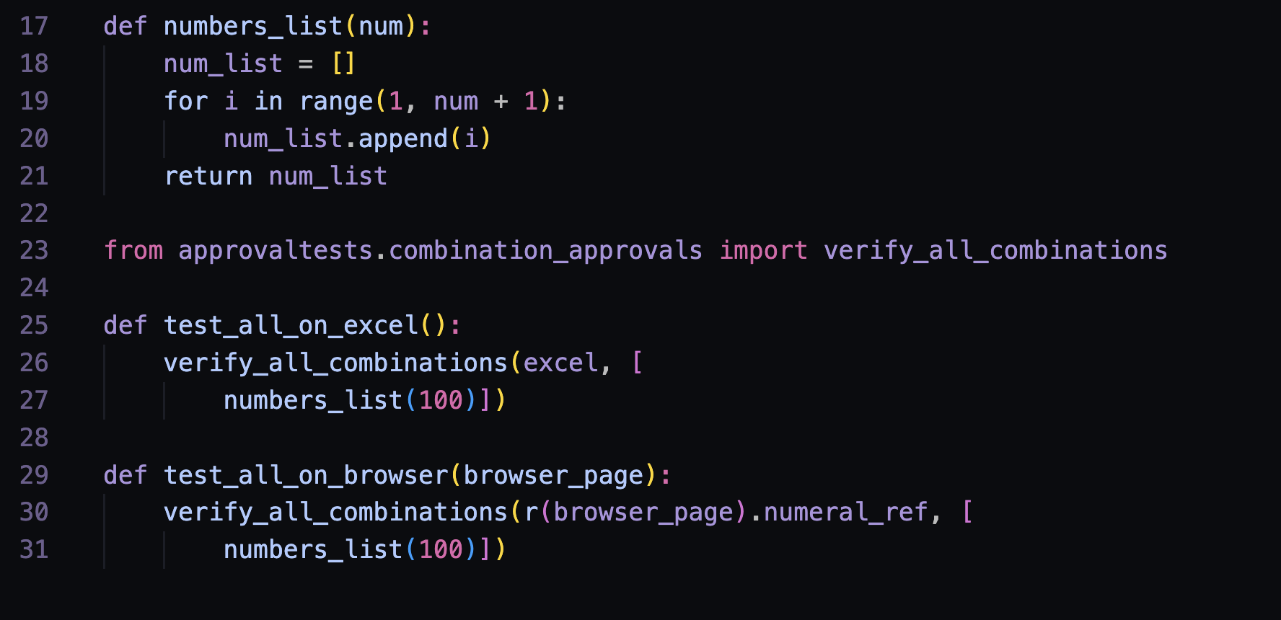
ApprovalTests
Done?

Slide 31
Note:
…business rules. You think you know them and yet you don’t.

Slide 32
Domain
Part I. Be the resident expert. Ask around.
Part II. Rules. More rules.
Part III. Find better experts.
Part IIII. Disagreeing with boundaries.
Part IIIII. Oracles.
Part VI. Find better oracles.
Part VII. No user would do what users would do.

Slide 33
Environment
Part I. Dependencies..
Part II. Interruptions. Both software and hardware.
Part III. People.
“People are not pure functions; they have all sorts of interesting side effects.” - Engineering Management for the Rest of Us, Sarah Drasner
… nor are pure functions if you grow the boundary of what might fail.

Slide 34
1. Legal / Ethical
2. Intent / Implementation
3. Domain for the Layman
4. Domain for the Expert
5. Reference Implementation
6. People Filtering 7. Interesting side effects
WE are
accountable

Slide 35
Applications are tester’s external imagination.
* audience suggestions
* genAI suggestions

Slide 36
A majority of the production failures (77%) can be reproduced by a unit test.
https://www.usenix.org/system/files/conference/osdi14/osdi14-paper-yuan.pdf
Through https://www.slideshare.net/Kevlin/the-error-of-our-ways

Slide 37
Everything that does not need to be automated gets done while automating.
* Programming with thinking – quality of thinking matters
Notes:
Note: pipeline restarts and does not show reliability. Development uses latest hw+sw and test environments use simple setups. You need to be intentional for this to be true, it takes that contemporary attitude of understanding how you automation task maps to getting everything done.

Slide 38
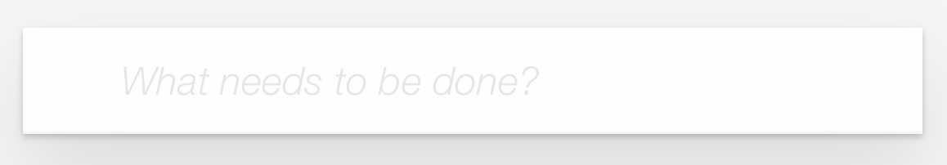
How Would You Test This?
Visual
Functional
Purpose?
https://todomvc.com/examples/vanillajs/

Slide 39
No Todos
✓ should hide #main and #footer
New Todo
✓ should allow me to add todo items
✓ should clear text input field when an item is added
✓ should trim text input
✓ should show #main and #footer when items added
Mark all as completed
✓ should allow me to mark all items as completed
✓ should allow me to clear the completion state of all items
✓ complete all checkbox should update state when items are completed
Item
✓ should allow me to mark items as complete
✓ should allow me to un-mark items as complete
✓ should allow me to edit an item
✓ should show the remove button on hover
Editing
✓ should hide other controls when editing
✓ should save edits on enter
✓ should save edits on blur
✓ should trim entered text
✓ should remove the item if an empty text string was entered
✓ should cancel edits on escape
Counter
✓ should display the current number of todo items
Clear completed button
✓ should display the number of completed items
✓ should remove completed items when clicked
✓ should be hidden when there are no items that are completed
Persistence
✓ should persist its data
Routing
✓ should allow me to display active items
✓ should allow me to display completed items
✓ should allow me to display all items
✓ should highlight the currently applied filter
Developer Intent

Slide 40
Designated Navigator (Voice)
Driver (Hands)
Navigators (Brains)

Slide 41
Agency.
* sense of control
Pull.
* timely for use
Notes:
Tell stories.
Agency – New tester asking why over taking a list of steps to complete.
– Not acting on a script
– Ownership
– Radiate intent!!!
Pull – New tester colleague wanting to be in all meetings but having no time to apply the knowledge. Yet one cannot ask for things they don’t know could exist!
– Optimize tasks and info for consumption
– Focus on impact and results

Slide 42
Testing is too important to be left for testers. Testing is too important to be left without testers.

Slide 43
Observe: notice more
Ideate: stop censuring
Let go: trust the process
Be Impressed: react
Support others: make them shine
Do something: experiment culture
Yes, and: combine
Support others
Observe
Ideate
Yes, and…
Be Impressed
Do Something
Let Go
* Metaskills of Improv, Simo Routarinne, proimpro.fi
Notes:
Observe: tester’s mile – child’s mile, adult’s mile; curious observation
Ideate: Fast thinking, accepting ideas, listen to feelings
Let go: Well planned is not yet started; perfection, fear of failure
Be impressed: Listen and act; psychological safety
Support others: Away from competition culture, win together; coaching
Do something: Action produces information; serendipity; experiment culture
Yes, and: producing more together

